Slide 1


S CIAL STUDIES
Perspective Essay Writing
Examine each source. Write a response in which you:
interpret each source, explain the perspective(s) presented, and discuss the links between the competing values of individualism and collectivism.
Identify and explain one or more of the relationships that exist among the sources.
Suggestions for Writing:
Organize your response to effectively address the tasks in the assignment.
Proofread and edit your response.

Slide 2
Sources
Analyzing
When analyzing ANY source, one should:
Identify & Explain the context of the source
  CONTEXT: the set of circumstances or facts that surround a particular event, situation, etc.
  Background info!
Identify & Explain the perspective of the source (purpose/message)
  Source’s Creator: Artist, speaker, singer, photographer
Use evidence from the source that supports this perspective
If possible, try to identify who (philosopher?) may share this perspective!

Slide 3
When analyzing PERSPECTIVE, consider:
WHO’S PERSPECTIVE?
  Attitude towards the topic?
    Sympathizer/Supporter/Critic OR No opinion
  Group (Society, ideology, religion, race, gender etc.)
  Context?
    Time?
    Location?
    Position? (Gov’t official etc, slave etc)
  Bias?
  May be one of the above, or any combination of all of them!

Slide 4
Format?
There is no real official format for this type of essay yet. Below are some suggestions:
Intro?
  Introduce the topic given in the question
  In this case, historical globalization
Perspective 1
Perspective 2
Perspective 3
Unifying Relationship

Slide 5
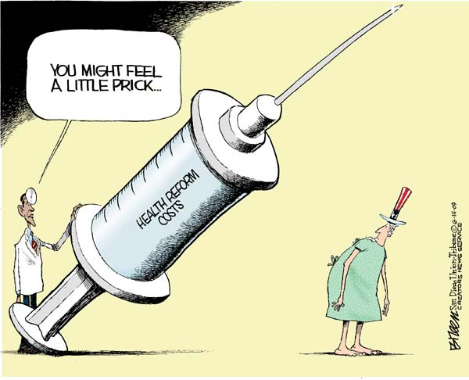
Source I
Artist uses sarcasm to show that he feels Obama’s view of this cost is either unrealistic or biased…
HUGE needle represents size of the cost of health reforms.
Uncle Sam is a symbol of America. In this case it is suggesting the cost of these reforms will be felt by all Americans.

Slide 6
Source II
"John Edwards says 'I'm just going to take all these people and I'm going to cover them in Medicaid.' Well, OK, fine, that's socialized medicine. If you want a system like England has, if you want a system like Canada has, if you want a system like Cuba has, that's where we're headed."
- Former New York mayor and Republican Party Leadership candidate Rudy Giuliani July 31, 2007, at a media event in Rochester, New Hampshire
Topic is healthcare reform
Speaker is discussing healthcare reform…specifically universal healthcare
Speaker is Republican, an ideology that traditionally supports a privatized system of healthcare.
His Republican perspective does not support “socialized” medicine, as is demonstrated in his distaste for other nations socialized healthcare.

Slide 7
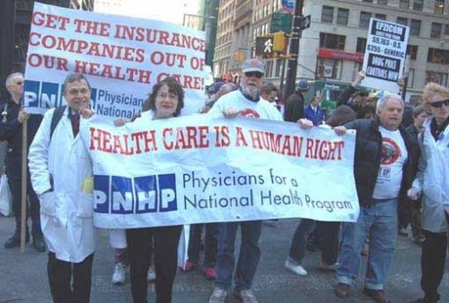
Source III
TEXT IS VERY SIGNIFICANT!!
Reveals specific perspective.
Reveals message – Healthcare is a human right…there is no place for privatized medicine.
Healthcare
Supporters of universal health program, as revealed in the phrase “National Health Program”.
Critical of privatized health insurance companies, as evident in “Get the insurance companies out of our healthcare.
Represent a group of doctors, but not ALL doctors…demonstrates even SOME in the profession support healthcare reform
This is significant because they are in the field, and see the everyday problems with the current system…their voice is credible.

Slide 8
Do's & Don'ts
Suggest a perspective.
Criticize the perspective
Use the source to support the perspective you’ve identified.
Summarize the source
Over-interpret the information
Suggest possible areas the source may be referring to (ie. Another area of concern supporting Source II is RWANDA)
Preach values (we should not have done this to the Africans OR I support this perspective… etc)
Give a bit of background info.
Make assumptions about info that isn’t there.

Slide 9
Analyzing Relationship
Relationship: a connection, association or involvement.
When analyzing a source for a common relationship, consider:
Do all the sources SHARE a perspective?
Do all the sources reveal the conflicting forces shaping the issue?
Do all the sources reveal possible solutions to an issue?
Be sure to:
Identify the relationship that exists among all the sources.
Explain the relationship that exists among all the sources.
  Straight from the rubric!!

Slide 10
